Slide 1
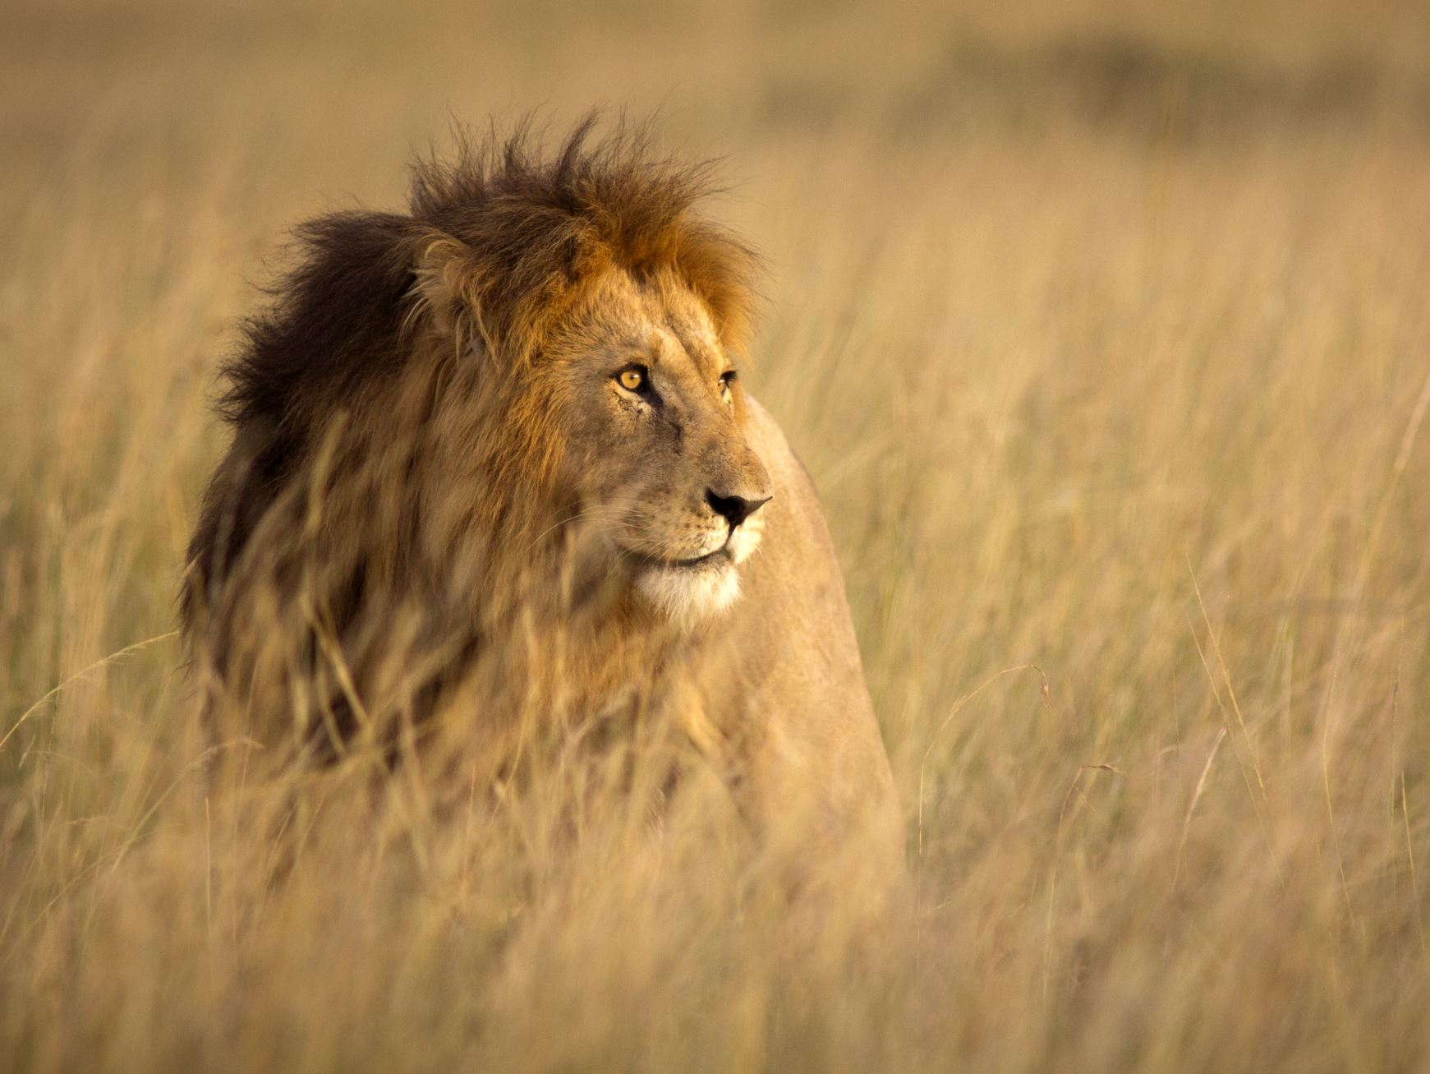
“The Righteous are Bold as a Lion”
Proverbs 28:1
Notes:
The righteous are bold when they speak God’s word, bold when they approach Him in prayer, and bold when they stand before Him in judgment.

Slide 2
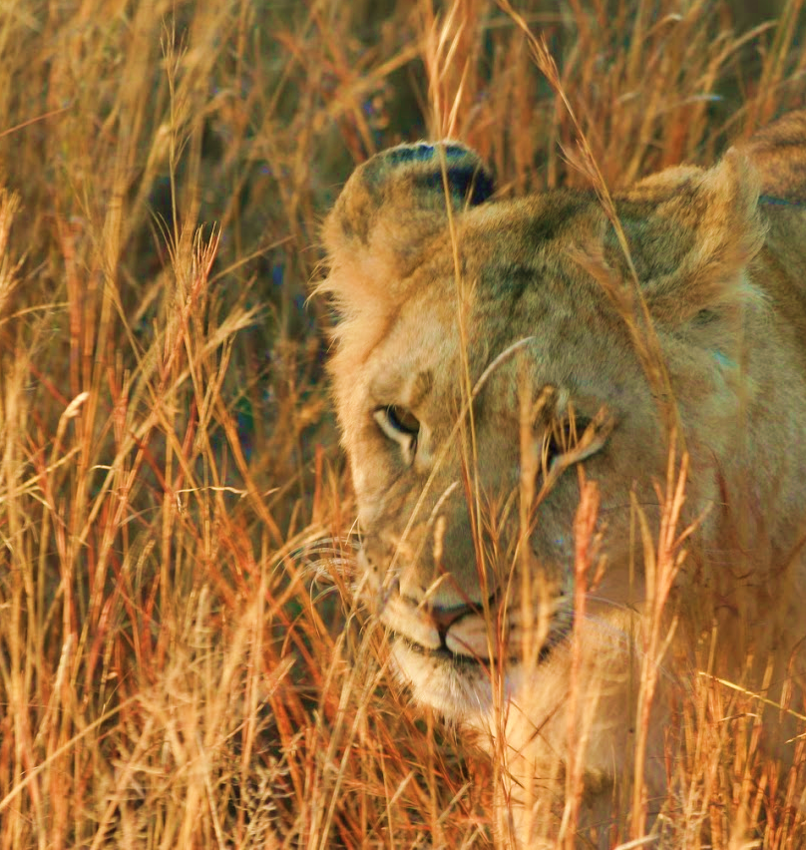
Bold in Speech
The apostles spoke with boldness (Acts 4:13).
When trouble arouse, they prayed for more boldness (Acts 4:29-31; Eph. 6:19-20)
The righteous become bolder in the face of opposition (Acts 9:27-29; 13:45-46)
Such boldness comes from a desire to please God, not men (1 Thess. 2:2-4).

Slide 3
Bold when Approaching God for Help
We can approach God with boldness and confidence (Ephesians 3:12; Esther 4:11).
We can come “boldly” because of our Great High Priest (Hebrews 4:14-16).
His blood enables us to stand in God’s presence (Hebrews 10:19-22).
He hears and helps us (1 John 5:14; Hebrews 13:6).

Slide 4
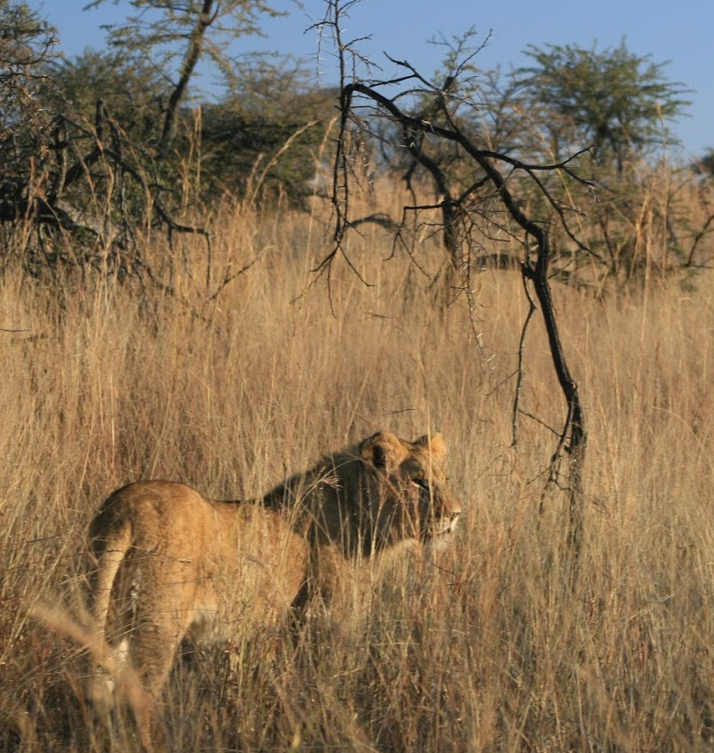
Bold at the Judgment
Judgment is inevitable (2 Corinthians 5:10)
We can be bold at the judgment if we love God and live in Him (1 John 2:28; 1 John 4:17-18).

